Slide 1
How to negotiate Cardington Roundabout by Three Shires Driving Centre®

Slide 2
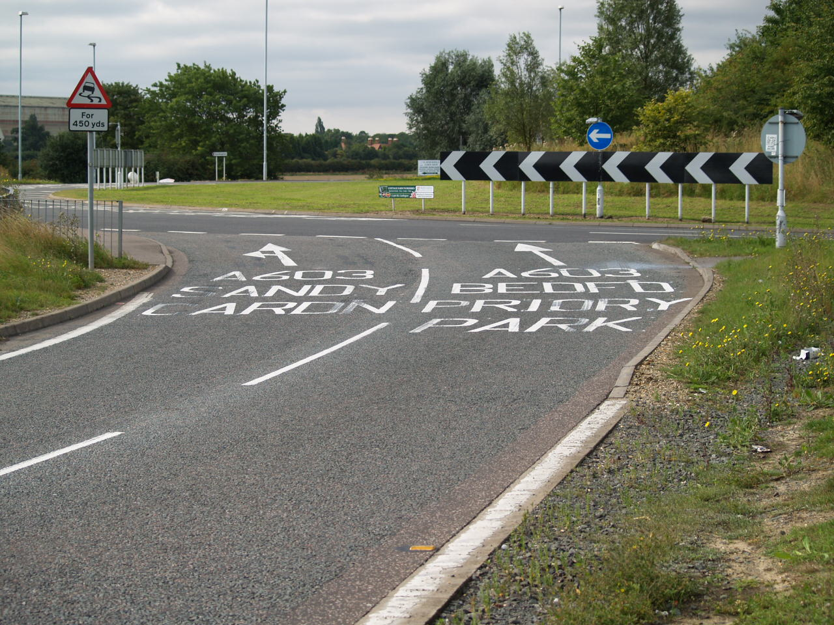
After leaving the bypass and heading for Bedford
Approach in the right hand lane signalling right

Slide 3
Enter roundabout in right hand lane, signalling right.
Bedford

Slide 4
The left lane heads off to Cardington, be aware of vehicles approaching from your left
Use this lane

Slide 5
Now your lane splits into two, move to the left, marked Bedford
Move to left

Slide 6
Stay in that lane and keep signalling right
Stay in this lane

Slide 7
Keep to the far left lane, signalling right
Stay in this lane

Slide 8
When you pass the lamp post, signal left
Signal left here

Slide 9
Stay in lane, be aware of vehicles from your right

Slide 10
Exit left

